Slide 1


Slide 2

WORKSHOP OBJECTIVE:
WORKSHOPS ARE PROVIDED FOR INTERNATIONAL AFFAIRS STAFF TO:
    WALK STUDENTS THROUGH THE GLACIER TAX PREP (GTP) SOFTWARE
WHICH HAS BEEN PURCHASED TO HELP F-1 STUDENTS COMPLETE THEIR U.S. FEDERAL TAX FILING REQUIREMENTS.
  ☑
WORKSHOP RESTRICTIONS:
DURING THESE WORKSHOPS INTERNATIONAL AFFAIRS STAFF ARE NOT ABLE TO:
  ADVISE WHICH TAX FORMS STUDENTS ARE REQUIRED TO COMPLETE
  HELP STUDENTS COMPLETE THEIR TAX FORMS
  PROVIDE TAX DOCUMENTS*
  RESOLVE ITIN ISSUES
  PROVIDE ANY TAX ADVICE
  ☒
  ☒
  ☒
  ☒
  ☒
  *OIA does have copies of 1042-S forms for any student who was issued this form by NSU

Slide 3
FORMS & DOCUMENTS NEEDED TO COMPLETE TAXES
ALL STUDENTS WILL NEED THE FOLLOWING:
RECORD OF ALL TRAVEL TO AND FROM THE US
  ☑
MOST STUDENTS MAY USE YOUR I-94 RECORD AT https://i94.cbp.dhs.gov
IF YOU TRAVELED BY BOAT OR LAND THOSE DATES MAY NOT BE RECORDED IN YOUR I-94 AND YOU WILL NEED TO REMEMBER THOSE DATES ON YOUR OWN.
SOCIAL SECURITY NUMBER (SSN)
  ☑
IF ISSUED
INDIVIDUAL TAXPAYER IDENTIFICATION NUMBER (ITIN)
  ☑
IF ISSUED
INCOME STATEMENTS
  ☑
DISCUSSED ON NEXT SLIDES
PREVIOUS YEAR US FEDERAL TAX RETURNS
  ☑
IF FILED

Slide 4
WHICH TAX FORMS DO I NEED?
AN OVER-SIMPLIFIED ANSWER THAT APPLIES TO MOST BUT NOT ALL STUDENTS IS:
DID YOU WORK IN THE UNITED STATES DURING 2022?
(INCLUDING ON-CAMPUS EMPLOYMENT)
YOU WILL NEED A W-2 FORM
  ☑
THIS FORM IS PROVIDED BY YOUR EMPLOYER IF NSU WAS YOUR EMPLOYER YOU MUST CONTACT PAYROLL@NOVA.EDU TO OBTAIN THIS FORM.

Slide 5
WHICH TAX FORMS DO I NEED?
AN OVER-SIMPLIFIED ANSWER THAT APPLIES TO MOST BUT NOT ALL STUDENTS IS:
DID YOU RECEIVE A SCHOLARSHIP FOR NON-QUALIFIED EXPENSES IN 2022?
- NON-QUALIFIED EXPENSES ARE ANYTHING OTHER THAN TUITION & FEES, INCLUDING HOUSING, FOOD, ETC.
- THIS DOES NOT INCLUDE SCHOLARSHIPS FROM YOUR HOME COUNTRY
YOU WILL NEED A 1042-S FORM
  ☑
THIS FORM IS PROVIDED BY THE ORGANIZATION THAT ISSUED YOUR SCHOLARSHIP. FOR MOST STUDENTS THIS IS YOUR UNIVERSITY.
IF YOU RECEIVED AN NSU SCHOLARSHIP FOR NON-QUALIFIED EXPENSES 1042-S FORMS WERE SENT TO YOUR HOME ADDRESS. OIA ALSO HAS A COPY OF THIS FORM FOR YOU. QUESTIONS ABOUT 1042-S FORMS SHOULD BE SENT TO PAYROLL@NOVA.EDU.

Slide 6
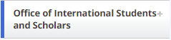


LET’S GET STARTED!
GO TO WWW.NOVA.EDU/INTERNATIONALAFFAIRS/
CLICK ON
CLICK ON
CLICK ON

Slide 7
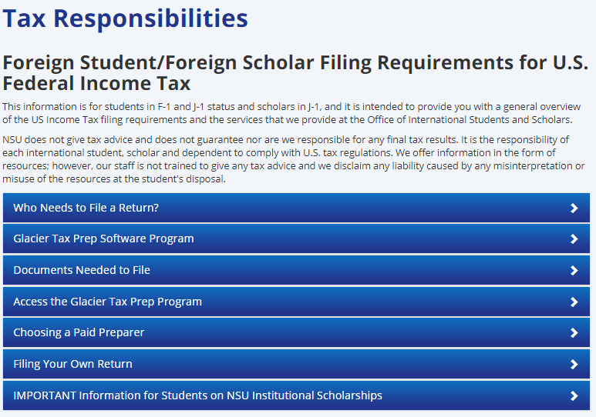

Slide 8
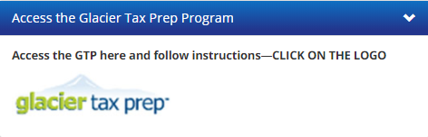
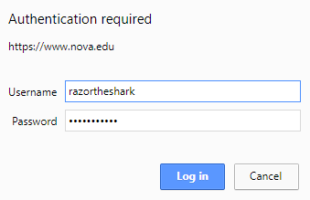
ENTER YOUR NSU CREDENTIALS

Slide 9
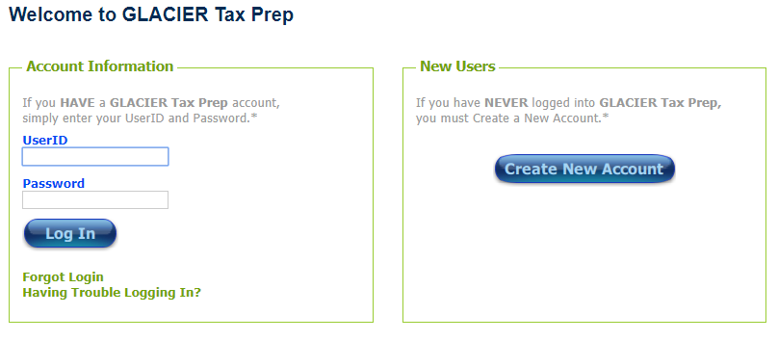
IF YOU HAVE PREVIOUSLY USED GTP SOFTWARE THEN ENTER THE ID & PASSWORD YOU PREVIOUSLY USED TO ACCESS YOUR ACCOUNT.
IF YOU ARE UNABLE TO LOGIN, USE THE FORGOT LOGIN SCREEN TO OBTAIN YOUR USERID & PASSWORD INFORMATION.
NOTE: MANY STUDENTS WHO HAVE USED GTP IN THE PAST TRY THEIR CURRENT NSU LOGIN CREDENTIALS. IF YOU HAVE CHANGED YOUR PASSWORD IN THE PAST YEAR THIS WILL NOT WORK. IF YOU CANNOT REMEMBER YOUR OLD PASSWORD YOU WILL NEED TO USE THE PASSWORD RESET.

Slide 10
BECAUSE GTP SOFTWARE IS SO EASY TO USE, WE ARE ASSUMING MOST INDIVIDUALS ATTENDING THESE WORKSHOPS ARE NEW USERS. If so, you will need to create a New Account.

Slide 11
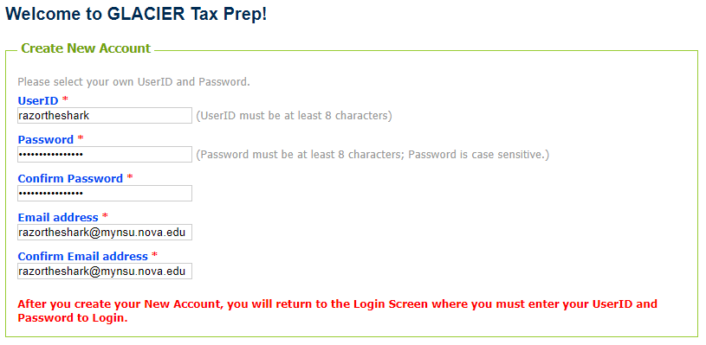
MOST STUDENTS WILL NOT BE ABLE TO USE THEIR NSU USERNAME AND PASSWORD BECAUSE MOST NSU USERNAMES ARE ONLY SIX DIGITS LONG.
YOU MAY CHOOSE IF YOU WILL USE YOUR MYNSU EMAIL ADDRESS OR A PERSONAL EMAIL ADDRESS, JUST MAKE SURE YOU WILL BE ABLE TO ACCESS THE EMAIL ADDRESS IN THE FUTURE.

Slide 12
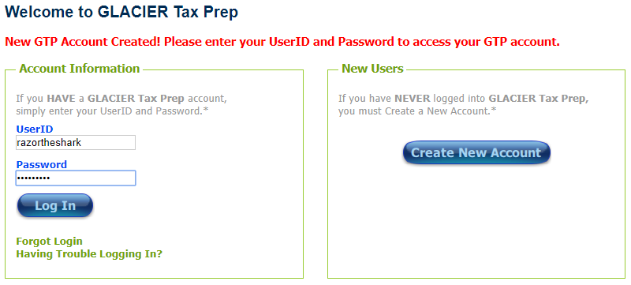
IT MAY LOOK LIKE IT DIDN'T WORK BECAUSE IT TAKES YOU TO THE SAME SCREEN, BUT DON’T WORRY! IT WORKED!
NOW ENTER THE USERNAME AND PASSWORD YOU JUST CREATED.

Slide 13
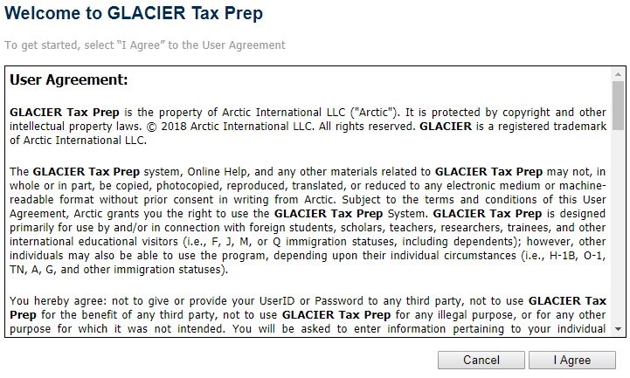

Slide 14
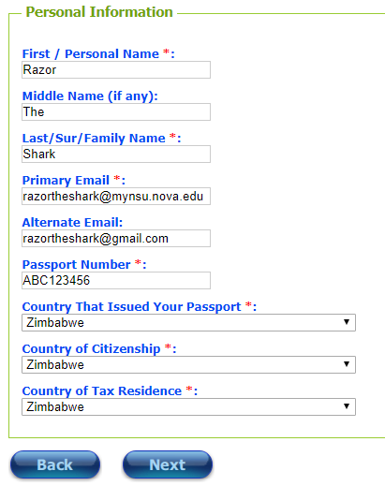
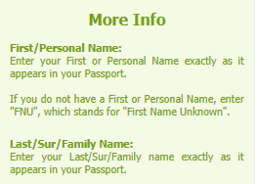
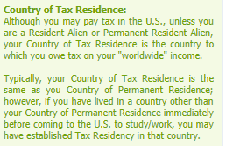
Click on:
Step ONE: Determine U.S. Tax Residency Status

Slide 15
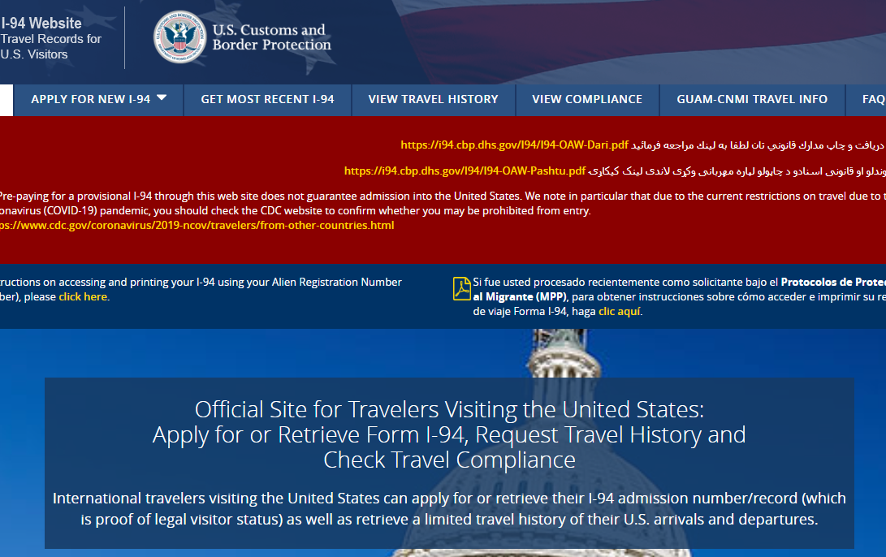
EVERY TIME YOU ENTERED THE US / EVERY TIME YOU LEFT THE US, SINCE 2013.
MOST STUDENTS MAY USE THE I-94 RECORD AT https://i94.cbp.dhs.gov FOR DATES 2013 AND LATER. IF YOU TRAVELED BY BOAT OR LAND THOSE DATES MAY NOT BE RECORDED IN YOUR I-94 AND YOU WILL NEED TO REMEMBER THOSE DATES ON YOUR OWN, AS WELL AS ANY DATES PRIOR TO 2013.

Slide 16
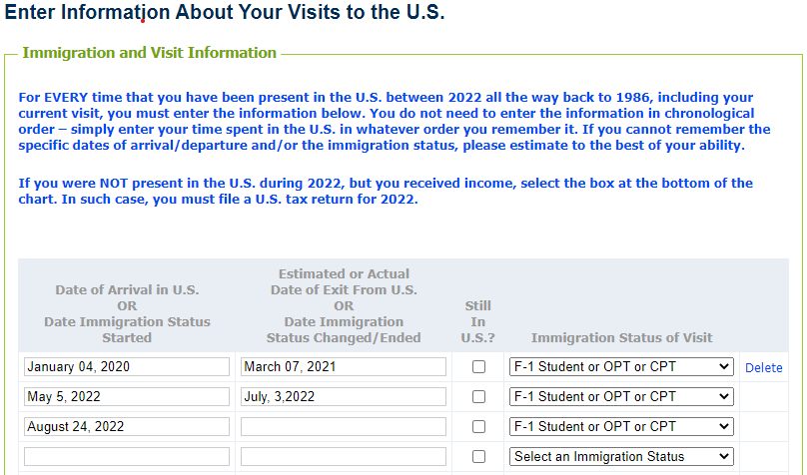
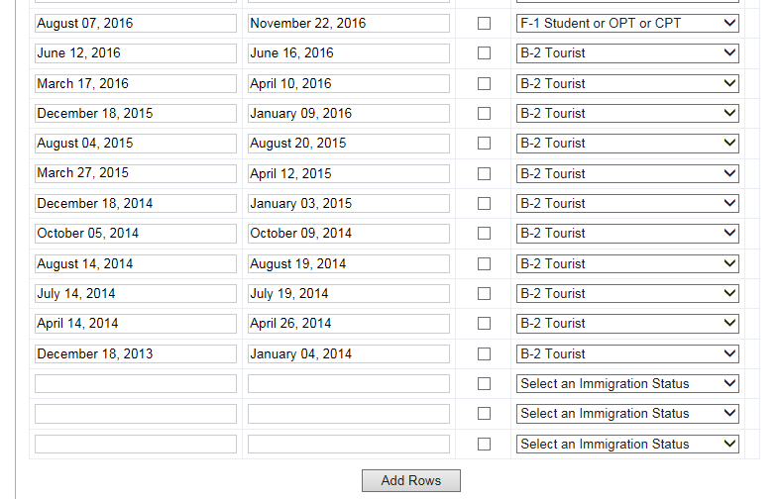
EVERY TIME YOU ENTERED THE US / EVERY TIME YOU LEFT THE US, SINCE 2013.
MOST STUDENTS MAY USE THE I-94 RECORD AT https://i94.cbp.dhs.gov FOR DATES 2013 AND LATER. IF YOU TRAVELED BY BOAT OR LAND THOSE DATES MAY NOT BE RECORDED IN YOUR I-94 AND YOU WILL NEED TO REMEMBER THOSE DATES ON YOUR OWN, AS WELL AS ANY DATES PRIOR TO 2013.

Slide 17
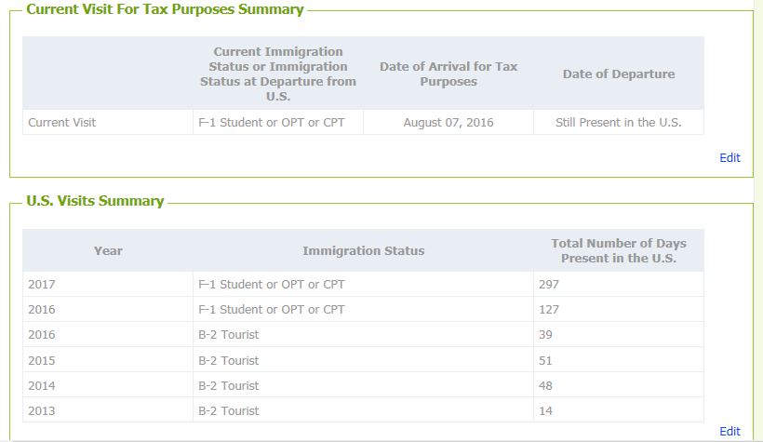

THIS SCREEN IS JUST “FOR YOUR INFORMATION”, TO SUMMARIZE WHAT YOU ENTERED.

Slide 18
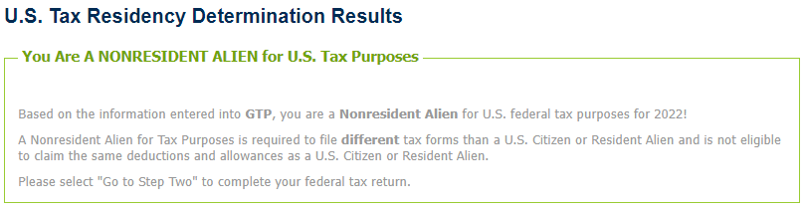
YOU CAN USE GLACIER TAX PREP FOR YOUR TAXES
  ☑
AS GLACIER TAX PREP SOFTWARE IS DESIGNED ONLY FOR NON-RESIDENT ALIENS, IF THIS PAGE INFORMS YOU THAT YOU ARE NOT A NON-RESIDENT ALIEN FOR TAX PURPOSES THEN YOU WILL NOT BE ABLE TO USE GLACIER TAX PREP SOFTWARE.
  ☒

Slide 19
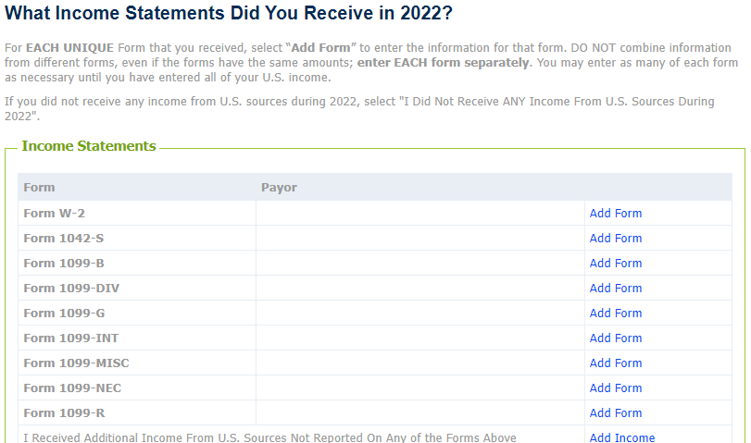
OPTION #1 – NO INCOME STATEMENTS
IF YOU DID NOT WORK IN THE UNITED STATES IN 2022 AND YOU DID NOT RECEIVE ANY US SCHOLARSHIPS FOR NON-QUALIFIED EXPENSES IN 2022, AND YOU DID NOT HAVE ANY OTHER SOURCE OF US INCOME IN 2022, CHECK THIS BOX.

Slide 20
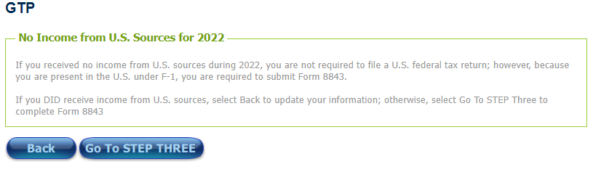
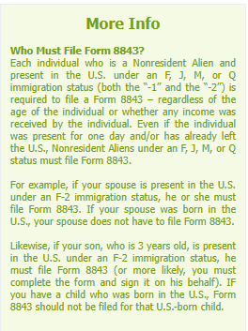
OPTION #1 – NO INCOME STATEMENTS

Slide 21
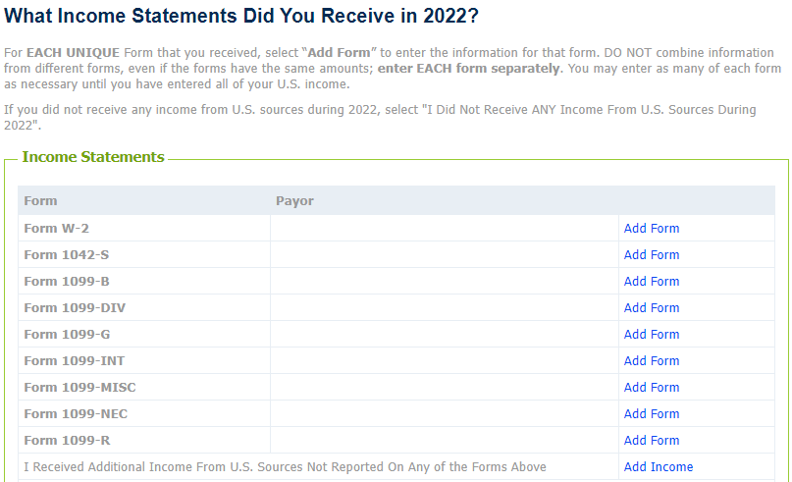
OPTION #2 – RECEIVED INCOME STATEMENTS
THE MOST COMMON FORMS RECEIVED BY NSU F-1 STUDENTS
W-2 –EMPLOYMENT INCOME
1042-S –SCHOLARSHIPS FOR NON-QUALIFIED EXPENSES INCOME

Slide 22
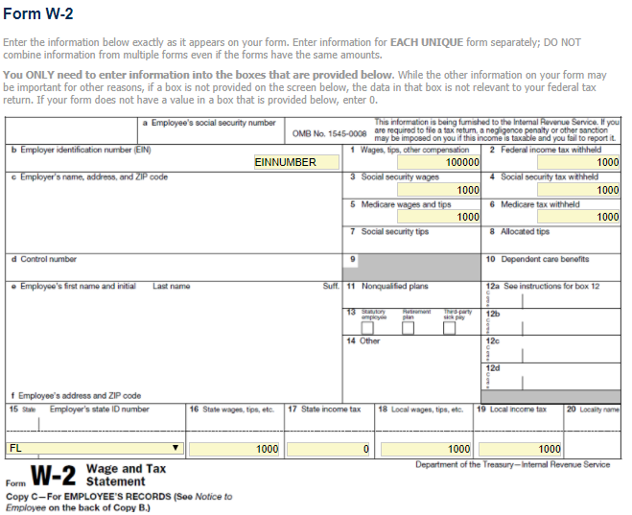
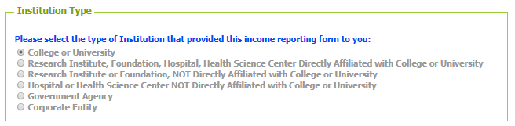
OPTION #2 – RECEIVED INCOME STATEMENTS
COPY INFORMATION DIRECTLY FROM THE W-2 ISSUED BY YOUR EMPLOYER
INDICATE WHAT TYPE OF INSTITUTION YOUR EMPLOYER WHO ISSUED THIS W-2 IS/WAS

Slide 23
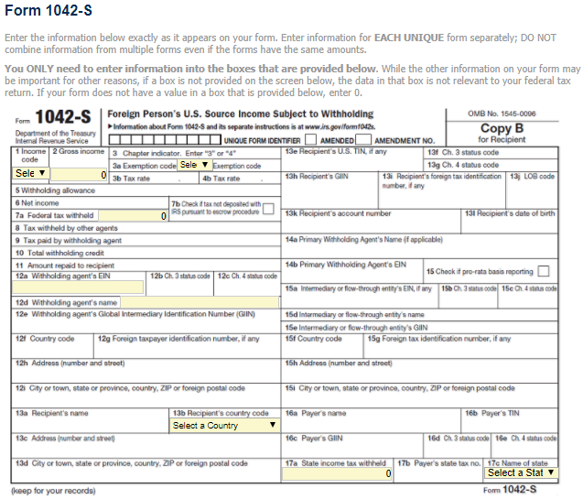
OPTION #2 – RECEIVED INCOME STATEMENTS
COPY INFORMATION DIRECTLY FROM THE 1042-S ISSUED BY THE SCHOLARSHIP PROVIDER
INDICATE WHAT TYPE OF INSTITUTION PROVIDED YOUR SCHOLARSHIP

Slide 24
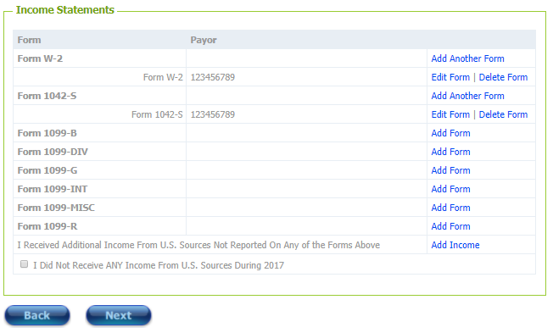
OPTION #2 – RECEIVED INCOME STATEMENT
YOU MAY HAVE MULTIPLE FORMS OF THE SAME TYPE. ADD EACH ONE SEPARATELY USING THE ‘ADD ANOTHER FORM’ OPTION.
ONCE YOU HAVE ADDED ALL OF YOUR INCOME STATEMENTS, SELECT NEXT.

Slide 25
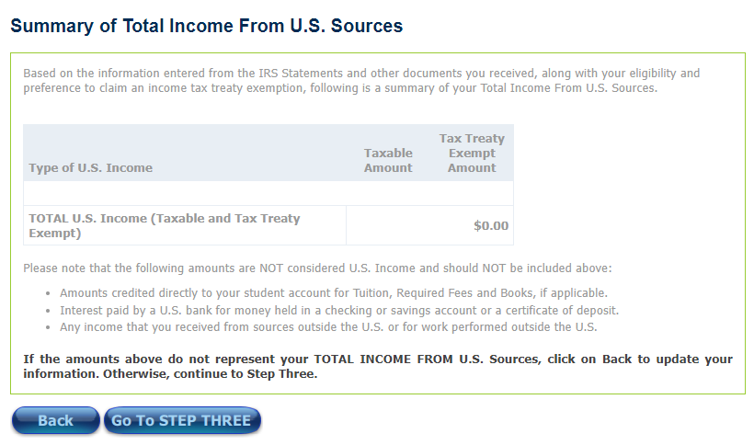
OPTION #2 – RECEIVED INCOME STATEMENT
THIS SCREEN IS JUST “FOR YOUR INFORMATION”, TO SUMMARIZE WHAT YOU ENTERED.

Slide 26
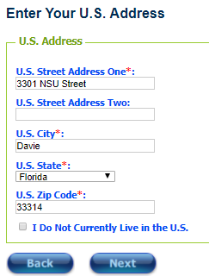
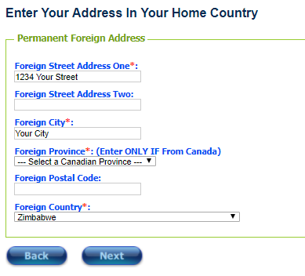
ALL STUDENTS – ADDRESS INFORMATION
IF YOU ARE AT THIS WORKSHOP, YOU PROBABLY HAVE A US ADDRESS. IF YOU ARE COMPLETING THE TAXES FROM YOUR HOME COUNTRY, AFTER HAVING LEFT THE US, YOU MAY NOT HAVE A US ADDRESS.
ALL F-1 STUDENTS & OTHERS FILING NON-RESIDENT ALIEN TAXES MUST HAVE AN ADDRESS IN THEIR HOME COUNTRY.

Slide 27
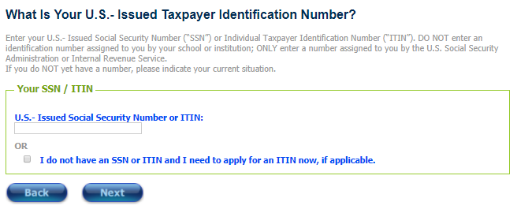
ALL STUDENTS – SSN/ITIN INFORMATION
IF YOU HAVE PREVIOUSLY BEEN ISSUED A SOCIAL SECURITY NUMBER (SSN) OR INDIVIDUAL TAXPAYER IDENTIFICATION NUMBER (ITIN) PROVIDE IT HERE.
IF YOU WERE GIVEN A SSN OR AN ITIN BUT DO NOT REMEMBER IT YOU MUST FIND THIS INFORMATION BEFORE YOU MAY MOVE FORWARD.
IF YOU HAVE NEVER APPLIED FOR A SSN OR ITIN BEFORE YOU MAY CHECK THE BOX TO APPLY FOR AN ITIN.

Slide 28
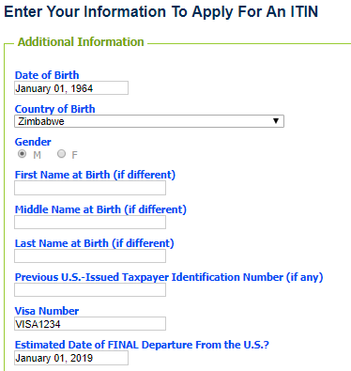
OPTION #2 – RECEIVED INCOME STATEMENT -
ONLY STUDENTS WHO DO NOT HAVE AN SSN/ITIN:
THIS SCREEN WILL APPEAR STUDENTS WHO HAVE INDICATED THEY DO HAVE INCOME BUT DO NOT HAVE A SSN/ITIN. BECAUSE A SSN IS REQUIRED FOR EMPLOYMENT, THIS WILL MOST OFTEN APPEAR FOR STUDENTS WHO WERE ISSUED A SCHOLARSHIP FOR NON-QUALIFIED EXPENSES (AND THEREFORE A 1042-S) BUT WHO DID NOT WORK.
ENTERING INFORMATION HERE WILL GENERATE THE W-7 ITIN APPLICATION FORM.
YOU ARE UNABLE TO APPLY FOR A SSN UNLESS YOU HAVE EMPLOYMENT.

Slide 29
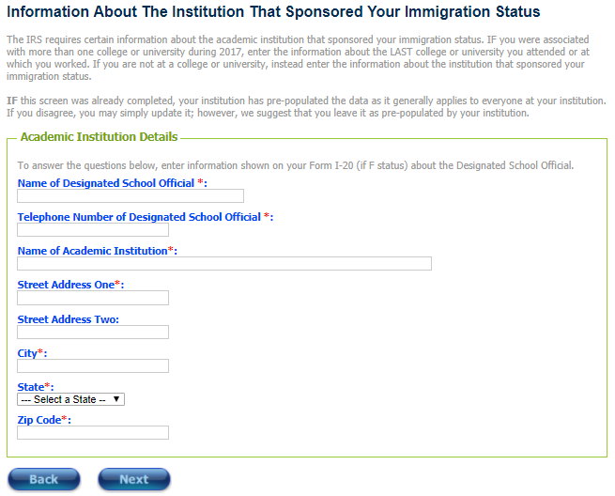
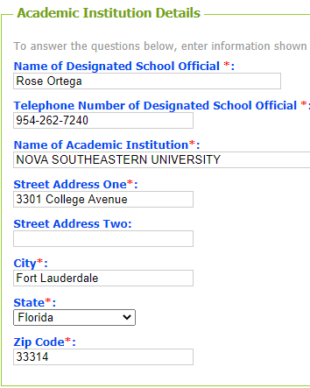
ALL STUDENTS – I-20 INSTITUTION
IF YOUR LAST VALID I-20 IN 2022 WAS ISSUED BY NSU, FOR THE MAIN (FORT LAUDERDALE/DAVIE) LOCATION, USE THE INFORMATION EXACTLY AS LISTED HERE.
IF YOUR LAST VALID I-20 IN 2022 WAS ISSUED BY NSU, FOR A REGIONAL CAMPUS LOCATION, USE THE INFORMATION AS LISTED HERE EXCEPT FOR THE STREET ADDRESS, CITY, STATE & ZIP CODE. USE REGIONAL CAMPUS INFORMATION FOR THESE FIELDS INSTEAD.
IF YOUR LAST VALID I-20 IN 2022 WAS NOT ISSUED BY NSU, CONTACT THE INSTITUTION FOR THEIR INFORMATION.

Slide 30
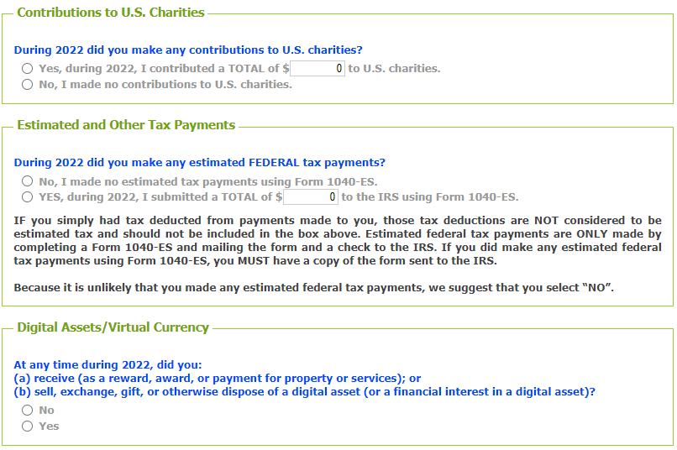
OPTION #2 Additional Information
THESE QUESTIONS MAY EXPAND INTO FURTHER QUESTIONS, DEPENDING ON YOUR ANSWERS.

Slide 31
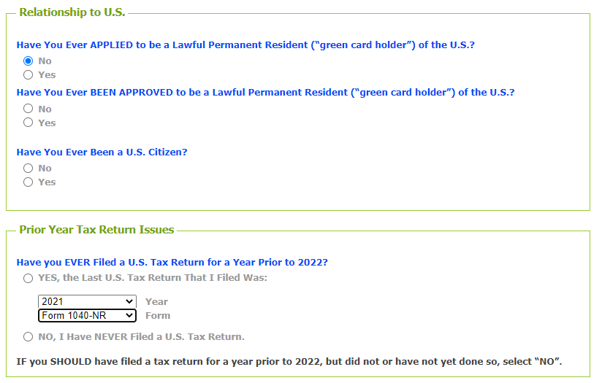
OPTION #2 – RECEIVED INCOME STATEMENT
THESE QUESTIONS MAY EXPAND INTO FURTHER QUESTIONS, DEPENDING ON YOUR ANSWERS.

Slide 32
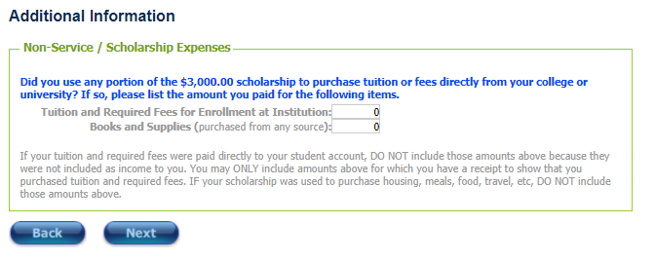
OPTION #2 – RECEIVED INCOME STATEMENT
IF YOU LISTED A 1042-S, YOU MAY RECEIVE THE FOLLOWING QUESTION. READ THE SMALL PRINT BEFORE ANSWERING.

Slide 33
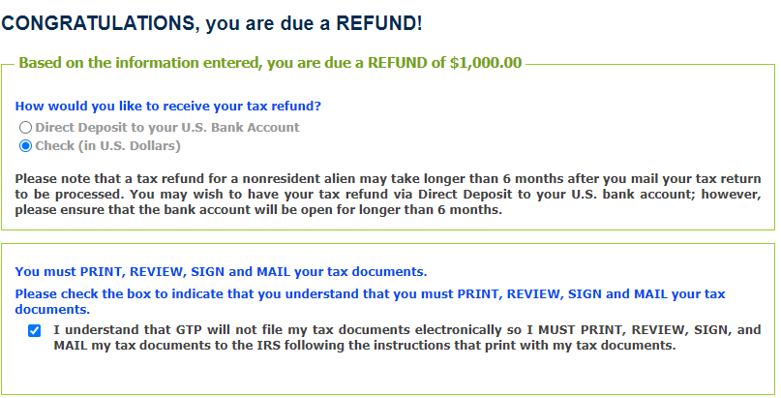
OPTION #2 – RECEIVED INCOME STATEMENT
THIS PAGE WILL TELL YOU WHAT YOUR TAX LIABILITY WILL BE. THERE ARE THREE POSSIBILITIES:
YOU OWE MONEY
YOU ARE OWED MONEY BY THE IRS
THE AMOUNT OF TAX YOU PAID EQUALS THE AMOUNT OF TAX YOU OWE AND THEREFORE YOU NEITHER OWE MONEY NOR ARE OWED MONEY

Slide 34
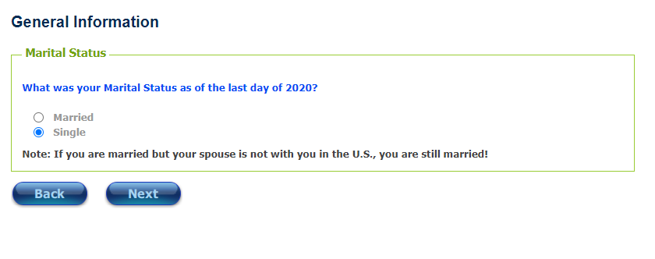
ALL STUDENTS – MARITAL STATUS

Slide 35
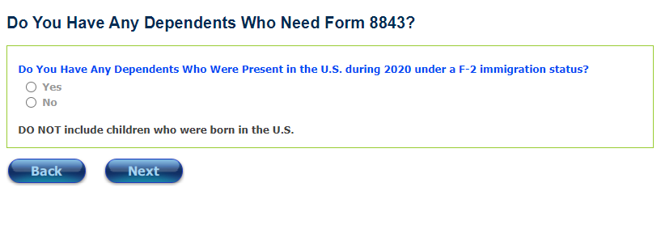
ALL STUDENTS – DEPENDENTS
AN 8843 MUST BE FILED FOR EVERY INDIVIDUAL IN THE US, INCLUDING THOSE ON F-2 VISAS.
SELECT YES IF YOU HAD A SPOUSE OR CHILD IN THE UNITED STATES ON AN F-2 VISA IN 2022.

Slide 36
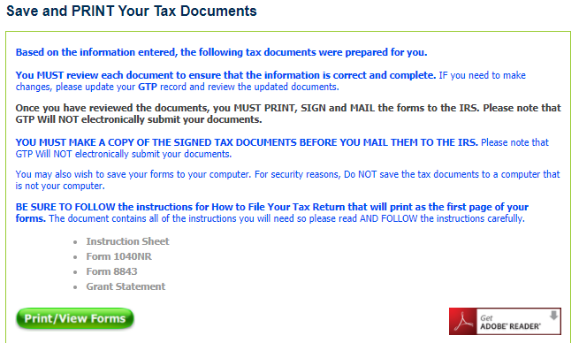
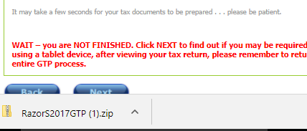

ALL STUDENTS – PRINT YOUR DOCUMENTS
ONCE YOU CLICK ‘PRINT/VIEW FORMS’ YOU WILL GET THE FOLLOWING MESSAGE:
THEN YOUR FORMS WILL APPEAR AS A DOWNLOAD:
PRINT AND SAVE THESE FORMS TO YOUR EMAIL/CLOUD/DRIVE/ETC.

Slide 37
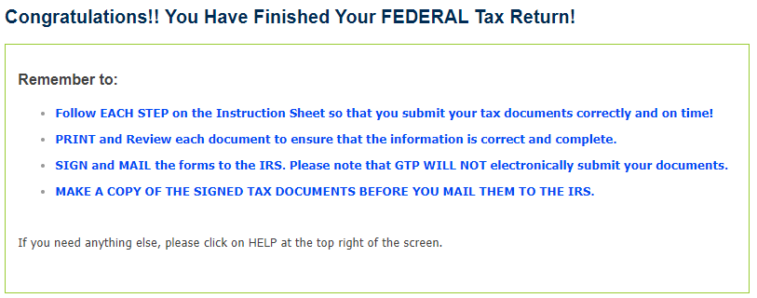
ALL STUDENTS – FINISHED FEDERAL RETURN!
FOLLOW THE INSTRUCTIONS TO MAIL YOUR FEDERAL TAX RETURN.
FLORIDA DOES NOT HAVE STATE INCOME TAX BUT IF YOU HAD ANY INCOME FROM ANOTHER STATE YOU MAY NEED TO FILE A STATE RETURN AS WELL.

Slide 38
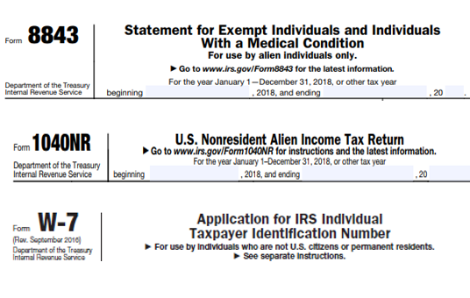
ALL STUDENTS –YOUR DOCUMENTS
THE TAX FORMS THAT APPEAR DEPEND ON THE INFORMATION YOU PROVIDED. BELOW ARE A FEW EXAMPLES:

Slide 39
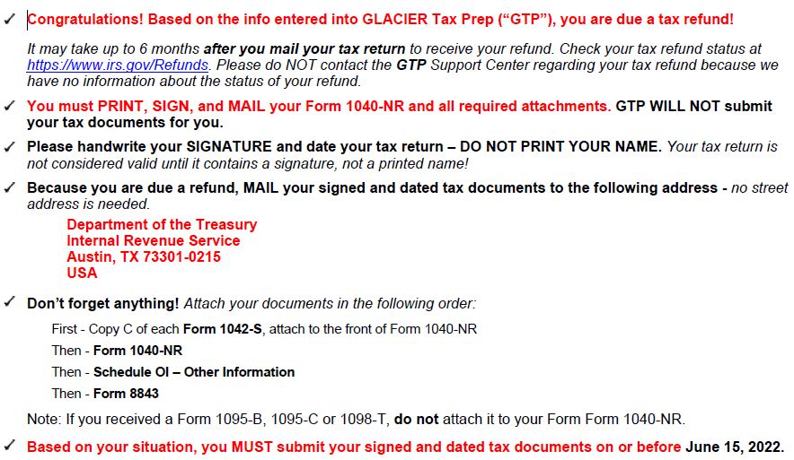
ALL STUDENTS –YOUR DOCUMENTS
ALL STUDENTS WILL HAVE A COVER PAGE THAT INCLUDES A LIST OF ALL OF THE DOCUMENTS AND INSTRUCTIONS ON WHERE TO MAIL THE DOCUMENTS.

Slide 40
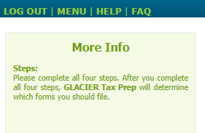
QUESTIONS ABOUT GLACIER TAX PREP SOFTWARE?
CONTACT GLACIER TAX PREP DIRECTLY USING THE HELP TAB FOUND AT THE TOP OF EVERY GTP PAGE.
QUESTIONS ABOUT TAXES
(INCLUDING FILING, DOCUMENTS, ITINs, W-7, ETC.)?
VITA TAX CLINICS
The Volunteer Income Tax Assistance (VITA) program offers free tax help to people who generally make $54,000 or less, persons with disabilities and limited English speaking taxpayers who need assistance in preparing their own tax returns. IRS-certified volunteers provide free basic income tax return preparation with electronic filing to qualified individuals. Find a VITA Clinic near you: https://irs.treasury.gov/freetaxprep/
IRS TAX ASSISTANCE CENTERS
Find a Tax Assistance Center (TAC) near you: https://apps.irs.gov/app/officeLocator/index.jsp. A full list of Florida TACs, including contact information and hours of operation: https://www.irs.gov/help/contact-my-local-office-in-florida

